Slide 1
Welcome to Organic Chemistry The Chemistry of Life
Chemistry 51A
Professor Weiss

Slide 2
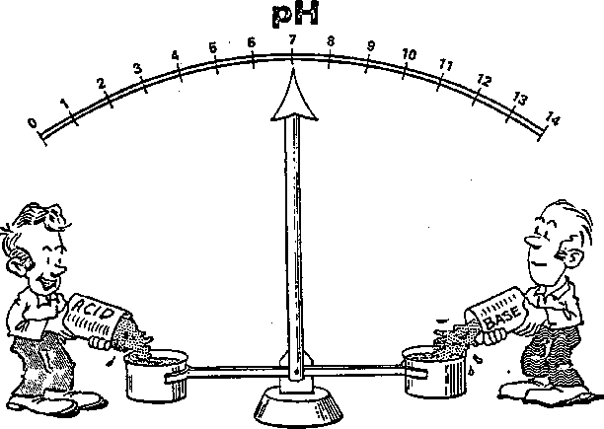
Week 2
Assigned reading: 2.1 to 2.8
Homework: Ch. 2 (due Oct. 10th)
2.1-2.12, 2.14-2.16, 2.19-2.20, 2.22-2.26, 2.30-2.33, 2.35, 2.38-2.41, 2.44, 2.50-2.51, 2.57, 2.68, 2.78
All problems in reading material and the problems specified on the website
Chapter 2: Acids and Bases
Brønsted-Lowry and Lewis
Chapter 3: Alkanes

Slide 3
Office hours
Professor Weiss (4122 NS-1)
Tuesdays 10:30-11:30 am
Wednesdays, 11:15 am - 12:15 pm
Floating OH Week 2: Friday 11-noon
Vote for Week 3 Floating OH times on Piazza (poll)
Teaching Assistants
Ryan Le Tourneau (Office hours: Mondays 3:00-4:00 pm, location: RH 523 )
Aoon Rizvi (Office hours: Tuesdays 3-4 pm, location: RH 228/229 )
Emily Sanders (Office hours: Wednesdays from 12:00-1:00, location: RH 523 )
Marshall Young (Office hours: Fridays from 4:00-4:50 pm, location: RH 523 )

Slide 4
Our story on Monday...
Draw Lewis structures to show bonding
Draw resonance structures to show where electrons locate
Get used to drawing skeletal structures
Do NOT use condensed structures, such as
CH₃CH₂CH₃
“s-character” determines electronegativity, bond length, and bond strength

Slide 5
Our story on Wednesday…

Slide 6
Our story on Friday...

Slide 8


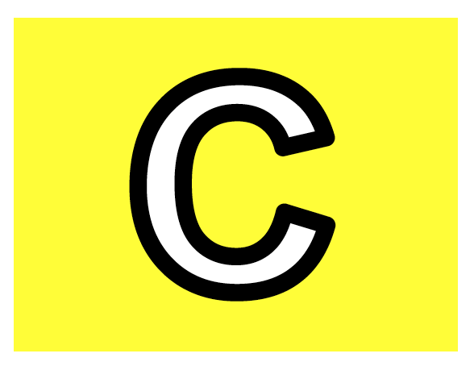

Who’s the acid and who’s the base?

Slide 9
The proton transfer reaction
Using curly arrows to show movement of electrons
A simple reaction used very often in o-chem

Slide 11
Which choice shows a correct acid-base reaction?

Slide 12
Some important conventions in o-chem
These will come up often

Slide 14
The pK_{a} scale
We will tell you when to memorize values
More important (for now) = meaning

Slide 16
What does a bigger (or smaller pK_{a} value mean?
An indication of relative protonation strength on a log scale

Slide 18
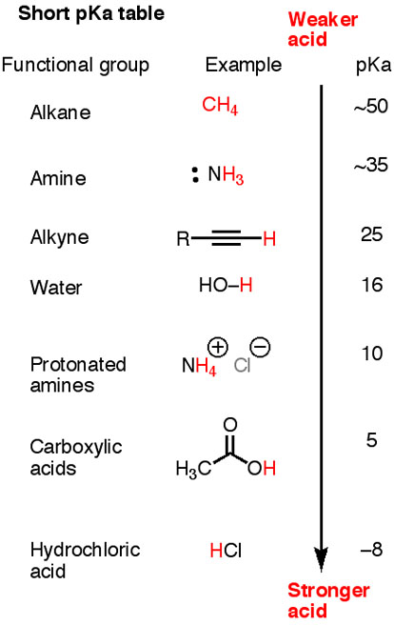
Compare this with Table 2.1

Slide 20
Which acid is strongest?

Slide 21
Predicting acid-base reactions
Stronger acid / base wins

Slide 23
Determining relative acidity
Influences on pK_{a}
Always refer to stability of the conjugate base

Slide 25
Electronegativity and pK_{a}
Element-based effects

Slide 27
Who’s the best base?
Br ⁻
F ⁻
I ⁻
Cl ⁻

Slide 28
Electron withdrawing effects
Electronegative atoms can stabilize conjugate bases

Slide 30
Resonance can stabilize pK_{a}
Resonance can stabilize the conjugate base

Slide 31
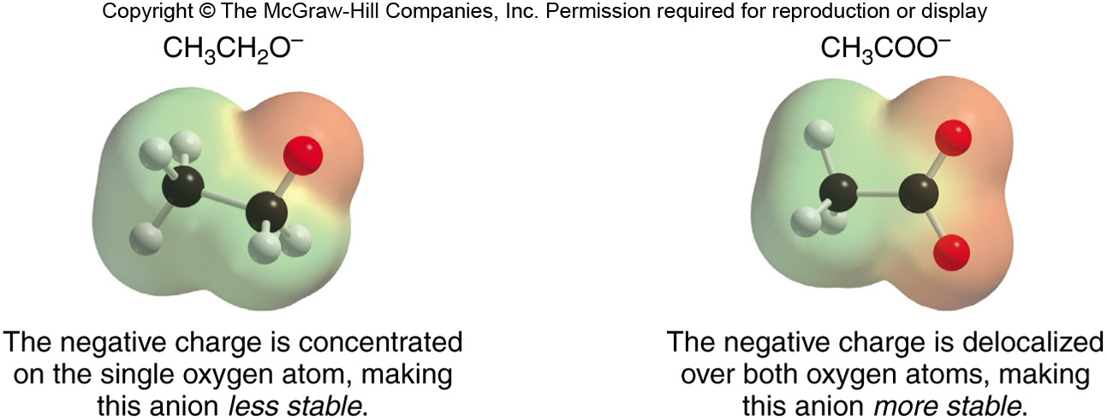
Figure 2.3

Slide 33
Hybridization effects on pK_{a}
“s-character” as a stabilizer of conj. base

Slide 35
Summary
Element, Inductive, Resonance, and Hybridization all effect acidity

Slide 36
Who’s the best acid?

Slide 37
Examples of acids in o-chem
Used extensively

Slide 39
Examples of bases in o-chem
Hydroxide is used as a convenient shorthand, but not really used much in the lab

Slide 41
Lewis Acids and Bases
Think electron pair in place of proton

Slide 43
Ch. 3: Molecules and their Functional Groups
Definitions used throughout this course

Slide 45
Intro to Functional Groups
The basic unit of reactivity in organic chemistry

Slide 47
Hydrocarbons
Good for fuel and structure with some notable reactivity

Slide 49
C-Z single bonds
Ubiquitous and crucial for reactivity.

Slide 51
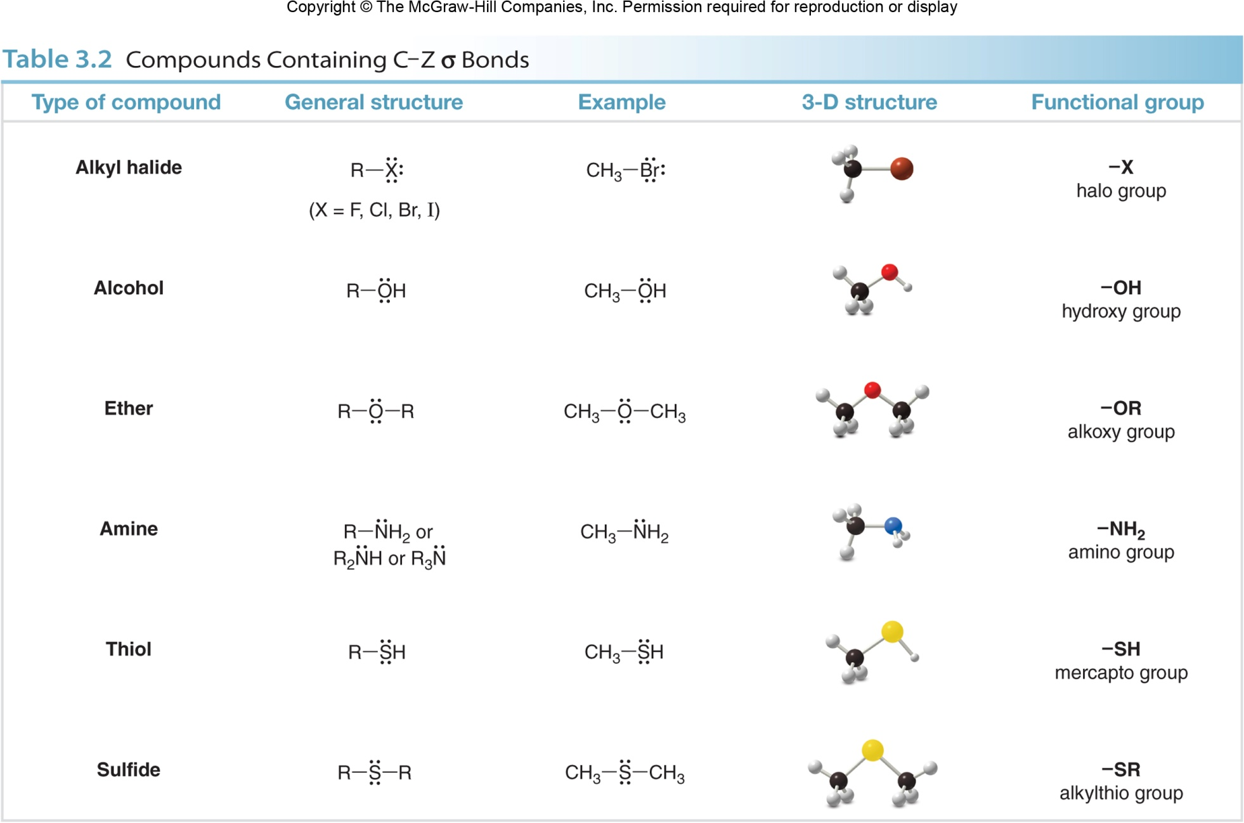
Memorize this table
Table 3.2

Slide 53
The carbonyl (C=O) functionality
Oh, the reactivity!
Basis for biochemistry

Slide 55
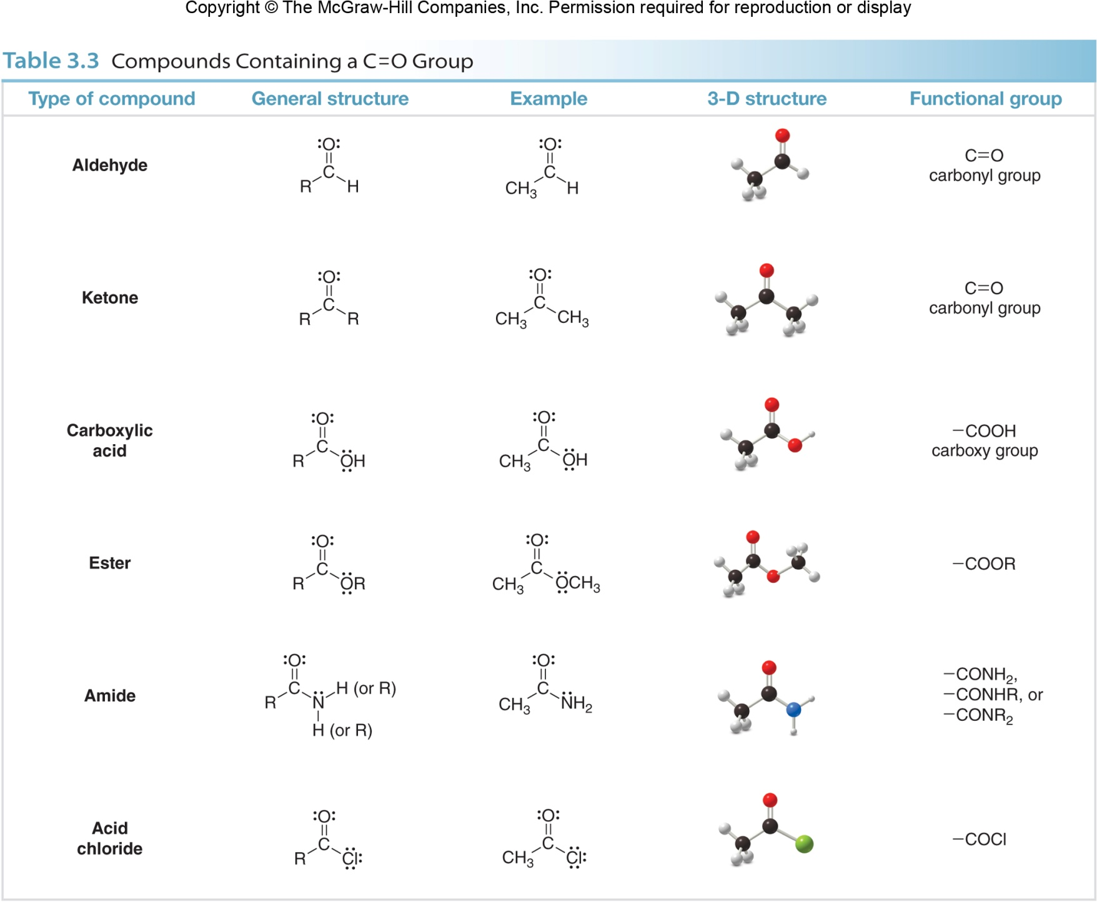
Memorize this table

Slide 57
Intermolecular Forces
Super-important in biology

Slide 59
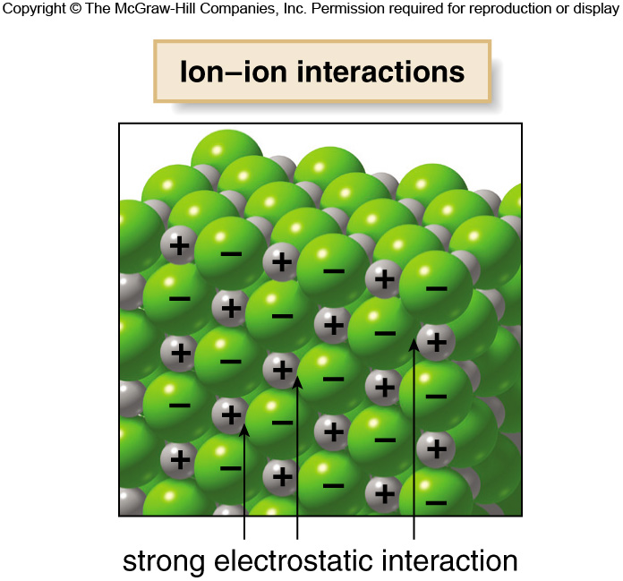
Charge-Charge or Coulombic Interactions
Long-range interaction subject to interference from shielding by other ions

Slide 61
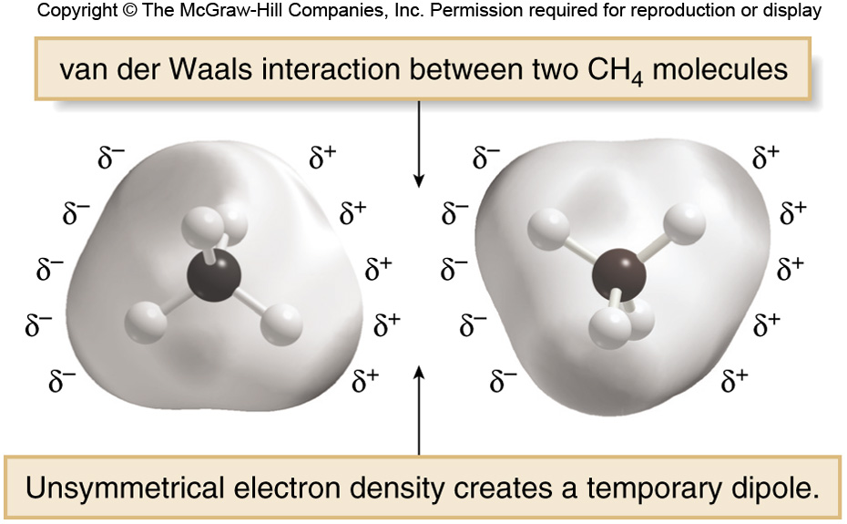
Van der Waals interactions
Methane-methane here:

Slide 63
Dipole-dipole interactions
Align to maximize interaction and stability

Slide 65
Hydrogen bonding
Always has a donor and an acceptor
Can be quite strong in organic solvent

Slide 67
Physical properties
Determined by the strengths of intermolecular, non-covalent forces

Slide 69
Boiling point (bp)
Convert compound from liquid to gas

Slide 71
Melting point (mp)
Convert solid into liquid

Slide 73
Solubility: ability to dissolve in solution
Like dissolves like, which is why organic solvents don’t dissolve ionic salts (e.g., NaOH)

Slide 75
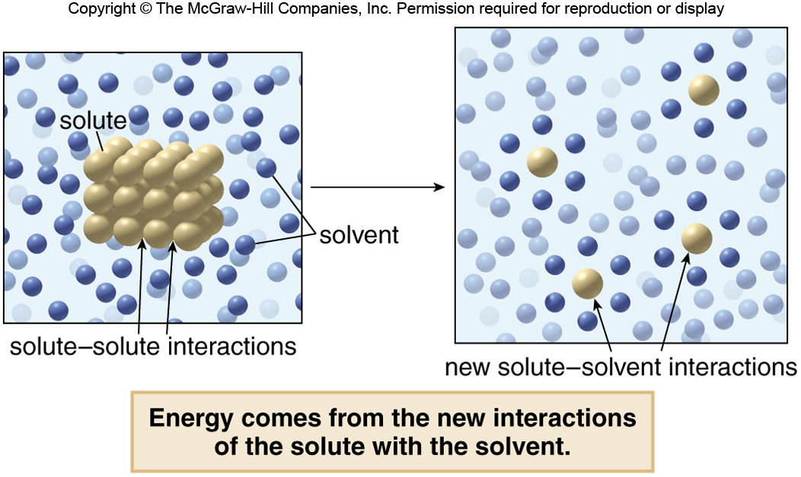

Slide 77
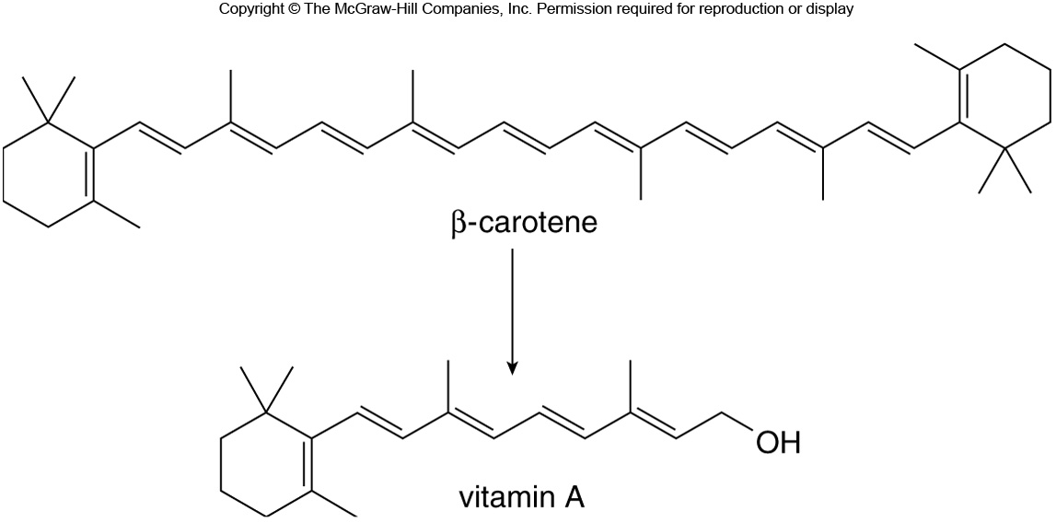
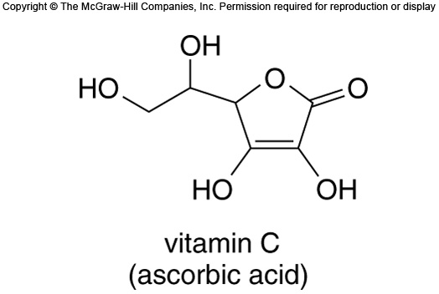
Vitamins as an example of complex organic molecules

Slide 79
How soap cleans dirt and oil
Hydrophobic tail, hydrophilic head group

Slide 81
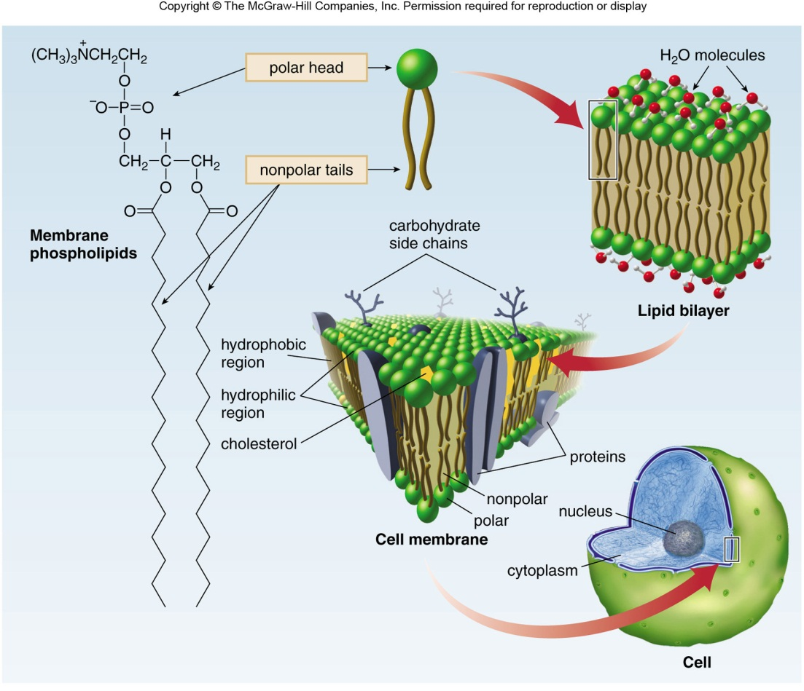
Cell membrane and transport
Impermeable hydrophobic barrier

Slide 83
Electrophiles: accept electrons
Electron-rich (nucleophiles) + electron-poor (electrophiles) react

Slide 85
Nucleophilic functionalities
Electron rich = lone pairs and pi bonds

